Slide 1
Robotics Engineering Notebook
Tony Deng

Slide 2
Table of Contents
Success criteria
- General goal
- Obstacle avoiding system
- Remote control system
- Different components
Mechanical design
Electrical design
Coding design

Slide 3
Success Criteria
General Goal
Complete the maze as smooth as possible
Avoid touching the wall and the red
Try to intergrade self-driving system with remote control system
Obstacle avoiding system
My car knows where to go when facing an obstacle
My car will not crash into the obstacle
Remote control system
My car can follow instruction of my joystick
User can control my car smoothly

Slide 4
Success Criteria
Different components:
Maqueen
My maqueen can move forward, backward, turn left and turn right
2. Microbit chip sender
My microbit chip sender interpret information from the handle and send it wirelessly to my receiver
3. Microbit chip receiver
My microbit chip receiver can receive information and command my maqueen car

Slide 5
Success Criteria
Different components
4. Joystick
My joystick can detect its position and send the x-value and y-value to my microbit sender
5. Octopus chip
My octopus chip can connect my handle with my microbit sender
6. Servo
My servo can turn left and right to detect its distance from the left and right wall
Ultrasonic sensor
My ultrasonic sensor can detect its distance from the obstacles, left wall and right wall.

Slide 6
Mechanical design

Slide 7
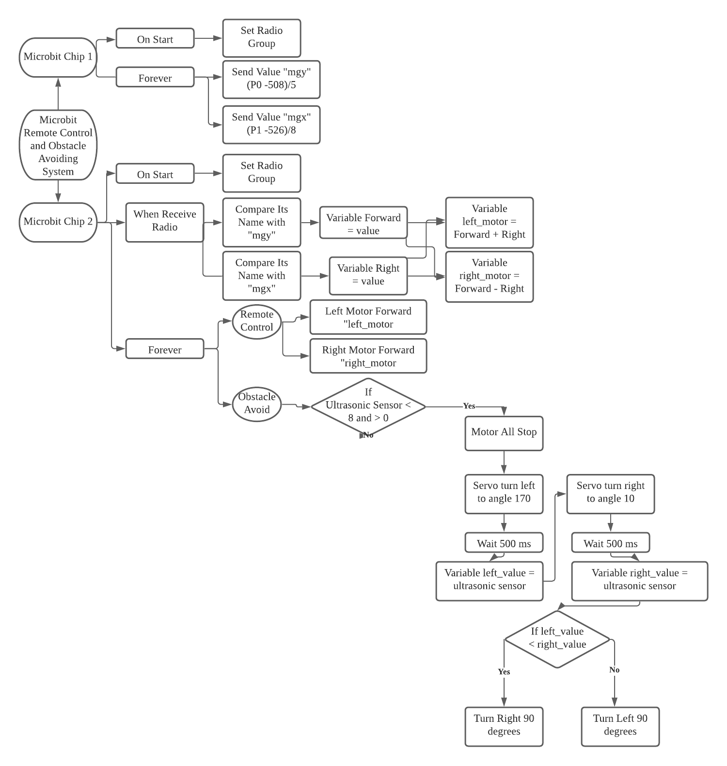
Programming design:

Slide 8
Mechanical design
The joystick will report a y-value and a x-value to my microbit chip.
Y-value connect to P0
X-value connect to P1
I minus the y-value by 508 to make sure the y-value is 0 when the joystick is on the center, and I divide the number by 5 to lower the speed.
I also do similar math to the x-value, and I divide it by 8 because I do not want it to turn too abruptly.

Slide 9
Resources: Remote Control: https://www.youtube.com/watch?v=2gPO7yVQys8 Obstacle Avoiding: https://www.hackster.io/mvirus784/obstacle-avoiding-robot-using-arduino-with-ultrasonic-sensor-3d0280

